Slide 1
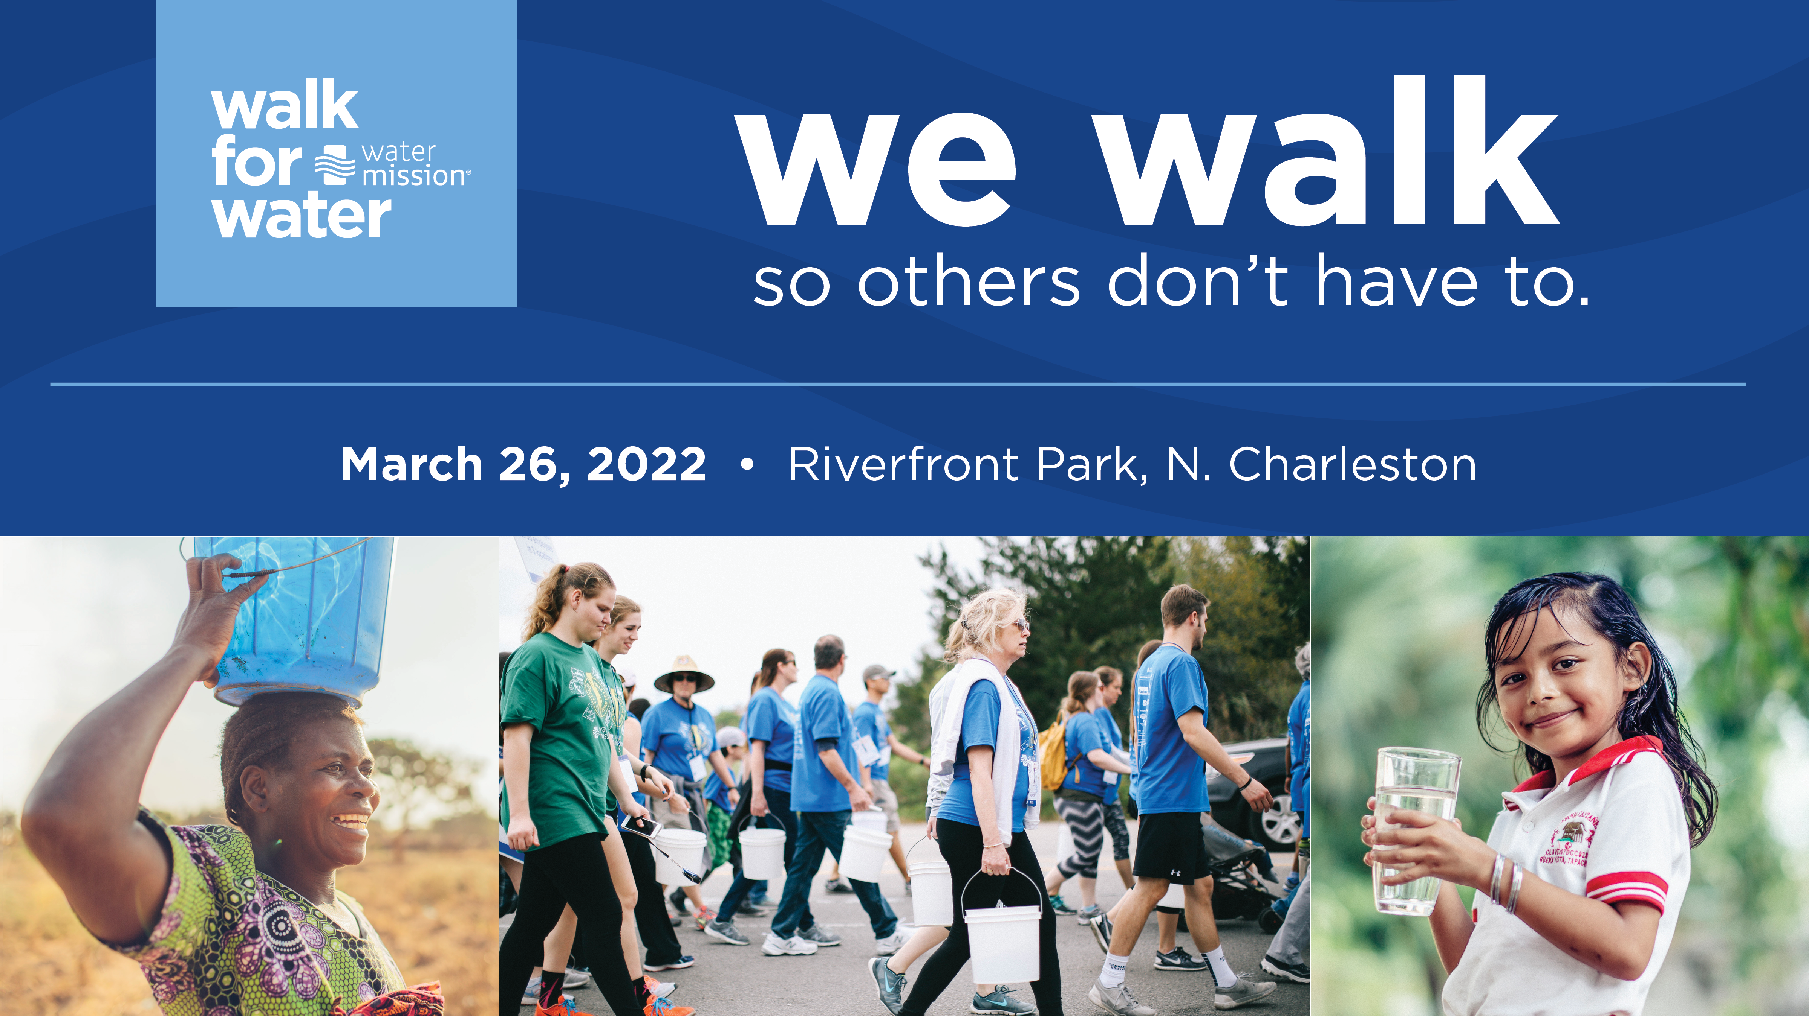
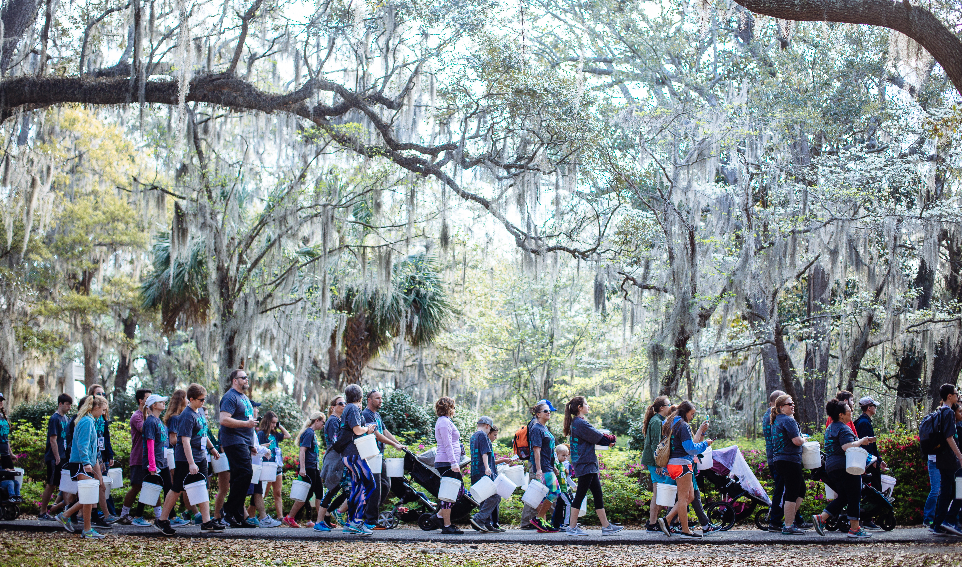

Slide 2
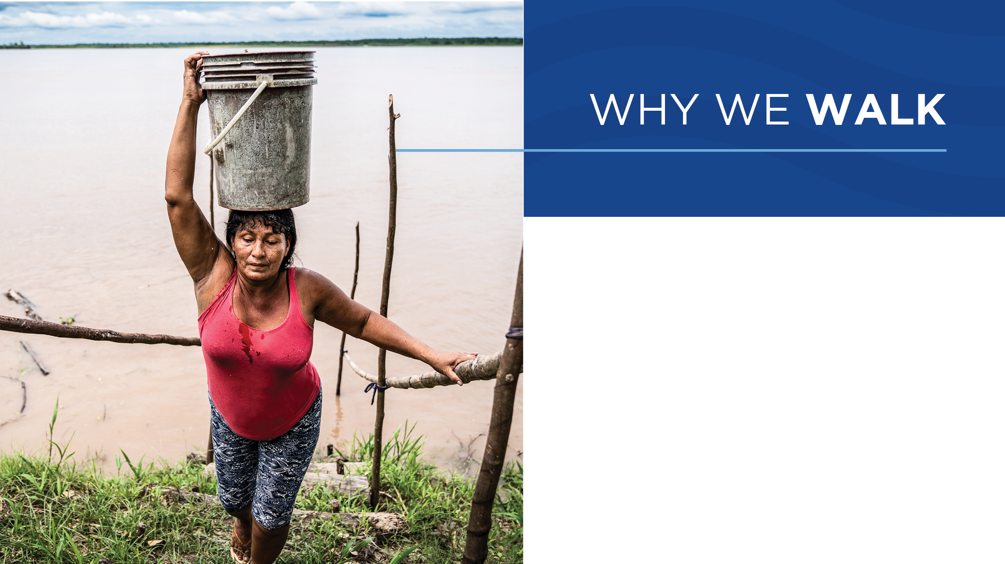
2.2 billion people lack access to safe water every day.
We walk to raise awareness of the global water crisis and funds that save lives.

Slide 3
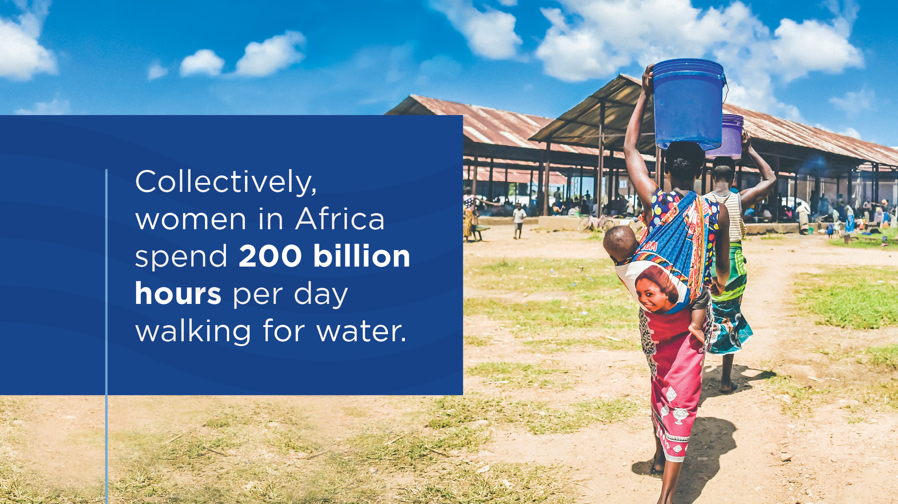

Slide 4
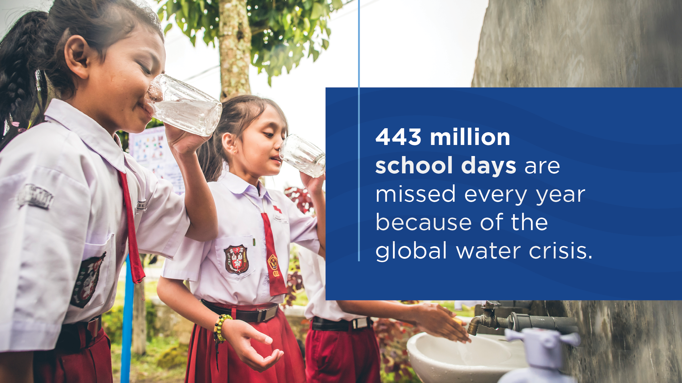

Slide 5
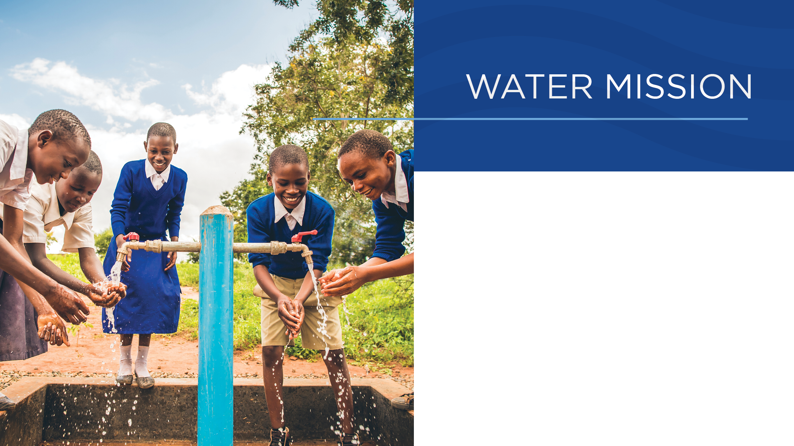
Water Mission is a nonprofit Christian engineering organization.
They build safe water and sanitation solutions in developing countries and disaster areas.
The work they do is motivated by faith in Jesus Christ, the Living Water.

Slide 6
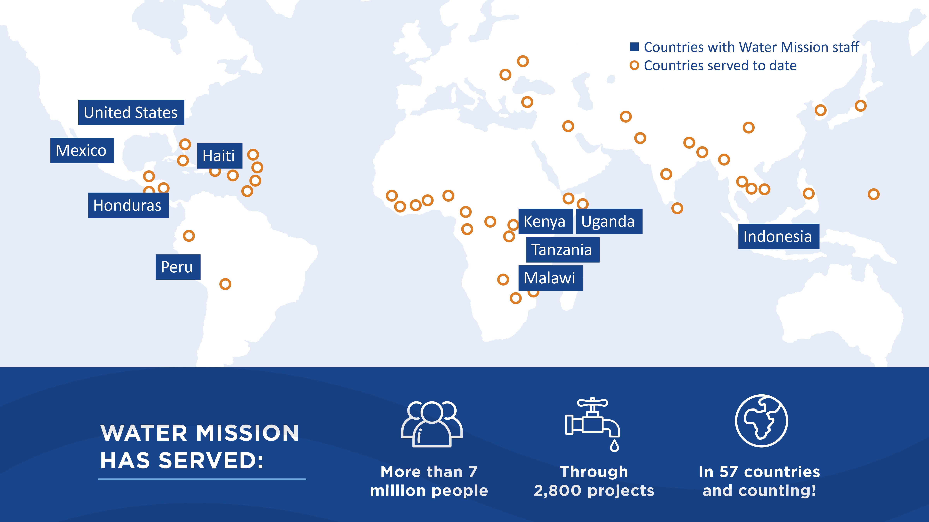

Slide 7
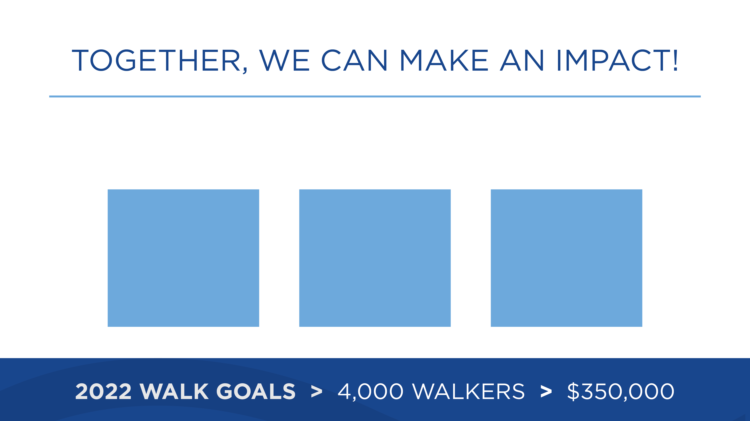
Funds raised through the Walk for Water change lives
through safe water and sanitation solutions.
HEALTH
EDUCATION
ECONOMY

Slide 8
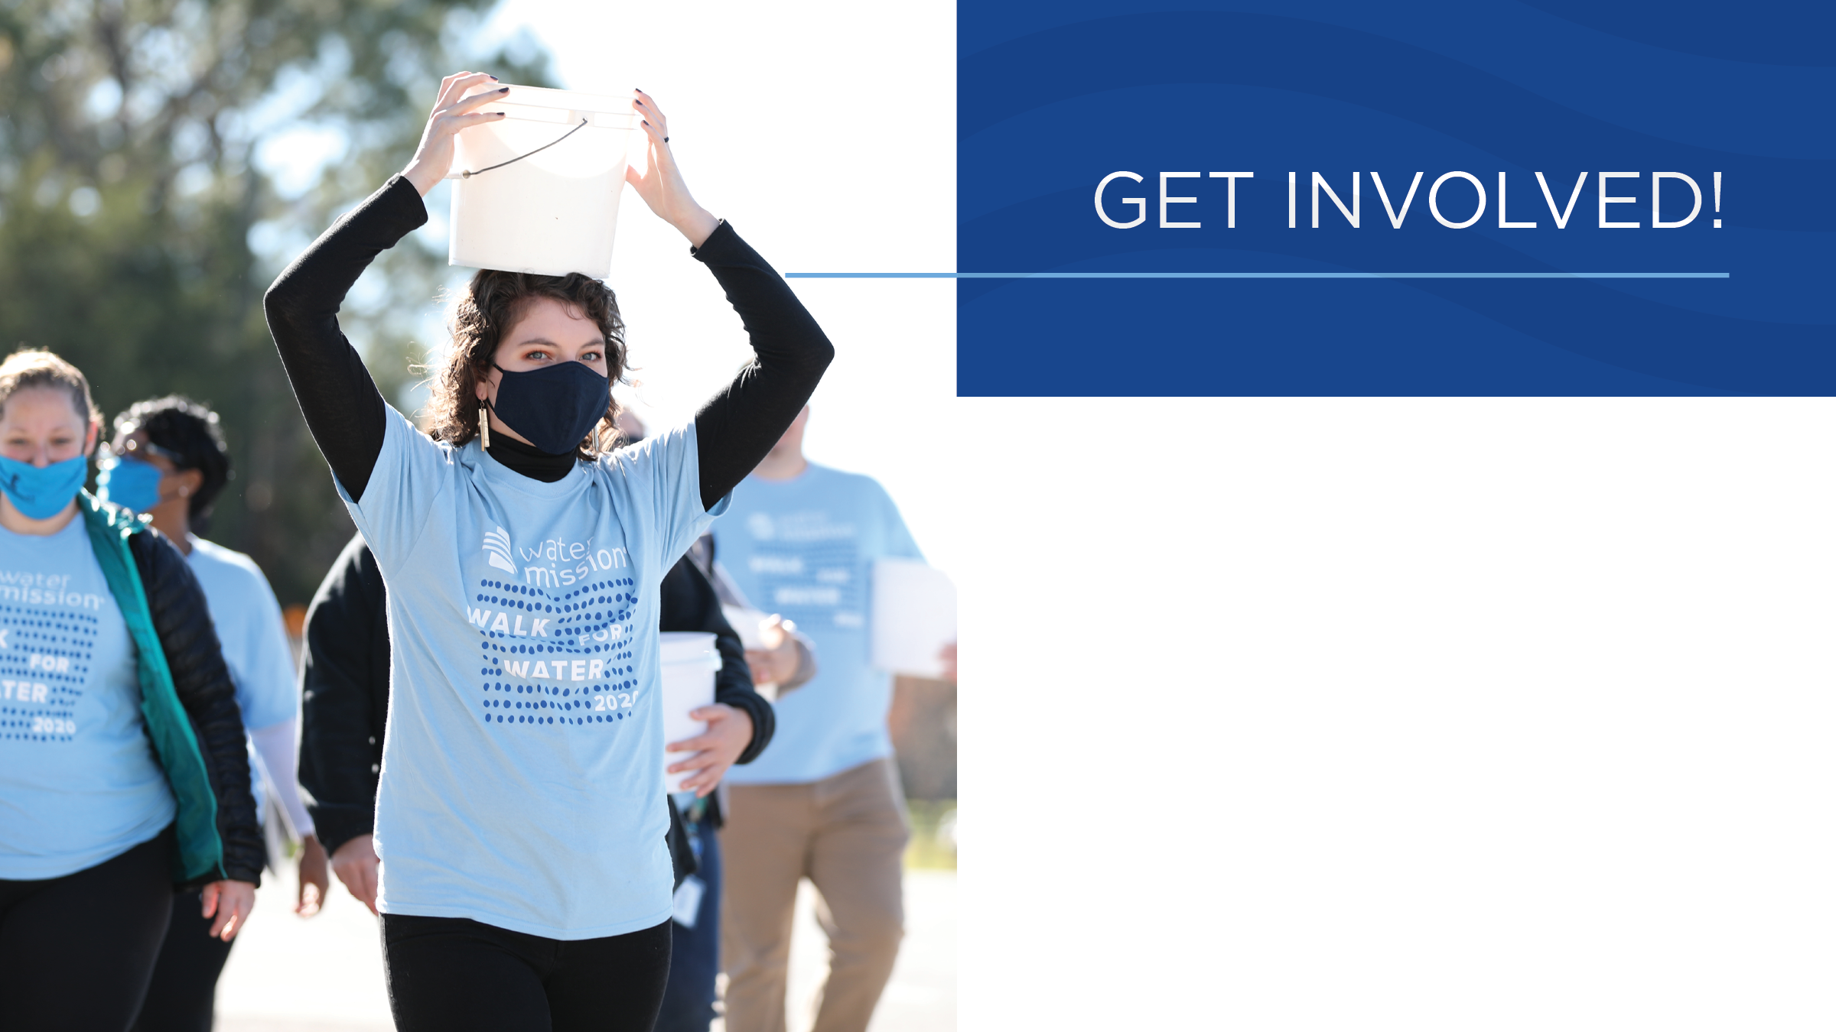
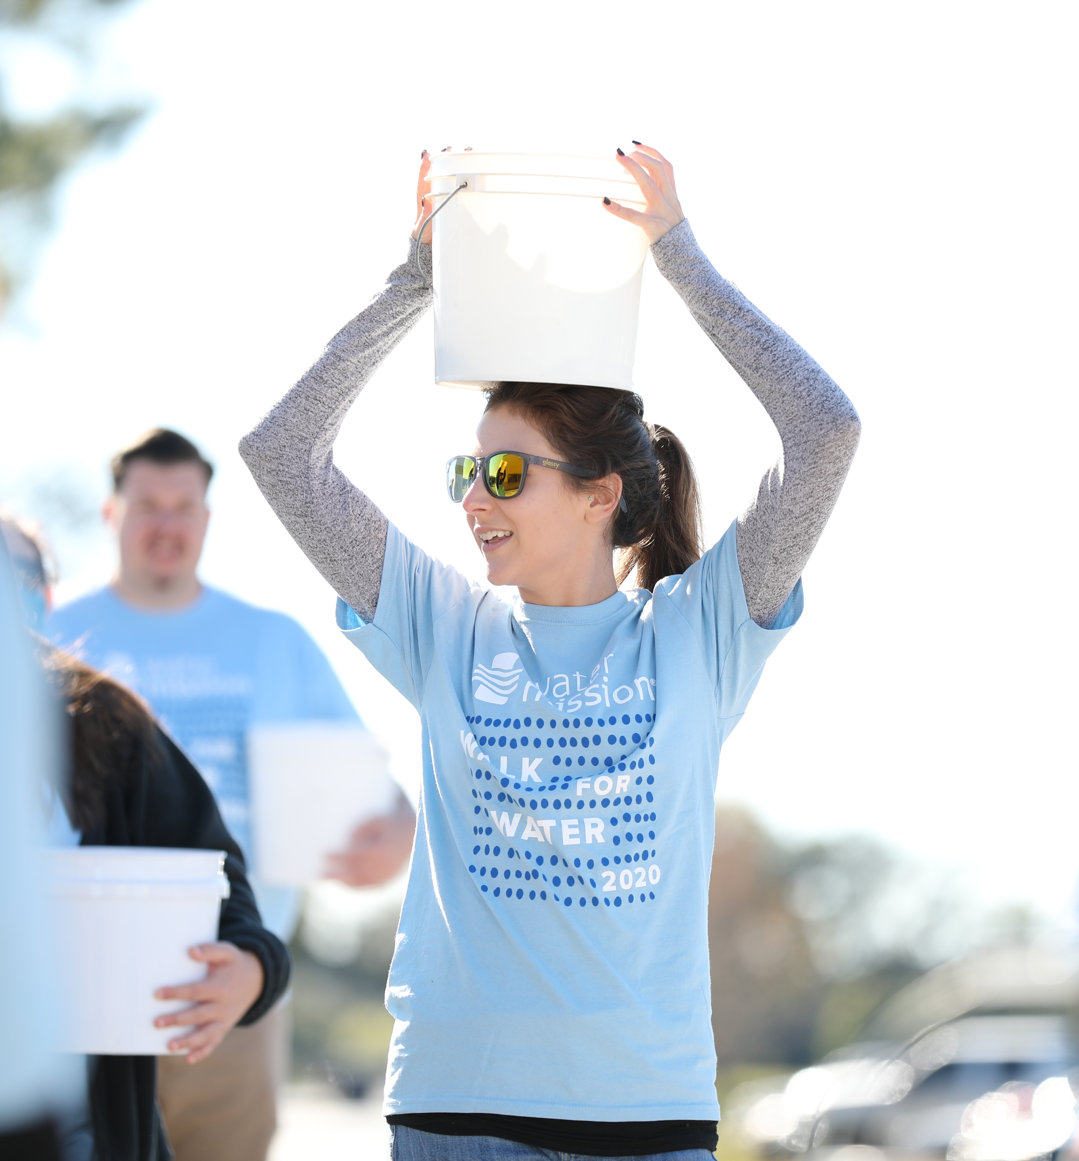
REGISTER at
charlestonwalk.org
CREATE A TEAM
and invite friends
RAISE FUNDS
to support solutions

